Slide 1
Unit/Division
Strategic Planning Process
Template

Slide 2
Agenda
Environmental Scan
Mission, Core Values
Envisioned Future
Establishing Goals, Objectives, Strategies, Tactics
Prioritize
Action Planning – next steps
Notes:
Unit Strategic/Business Planning Process
Step 1: Member/Nonmember Outreach
• needs assessment organized by professional role: teacher/related service provider (in-service), administrator, teacher-educator, student (pre-service teacher/related service provider)
• use CEC’s blast email system and (send 3x)
• needs assessment analysis and report
• timeline – 45 days from instrument development to results
Step 2: Strategy Session (one day, in-person)
• Establish or affirm: Mission, Vision, and Core Ideology (reference: CEC’s Mission)
• Identify: Goals, Strategies and Tactics
• Consider the plan for 36 months
• Include both internal and external goals
• Cite assignments and time lines for completion
• Align with business and budgetary planning cycle
Step 3: Review DRAFT Plan
• Conference call with board members (plan for one call 2 hours)
• Affirm each goal, strategy
• Make assignments (volunteer leaders, other?) and determine timeline for completion
• Vote to approve the final plan
Step 4 Preview Final Plan Members
• Blast email to members with the high-level aspects of the plan: Mission, goals and strategies – as for feedback and input for participation – volunteers.
• Post high-level plan elements on website
Step 5 Revamp Board Meeting Agenda around the Plan
• Focus agenda in two parts – content/program issues and business issues (minutes, financial reports, etc).
• Strategic plan goals will always be central to the board agenda, monitored and adjusted accordingly.
• Based on board meeting schedule issue a report back to the membership from the president (recommended quarterly).

Slide 3
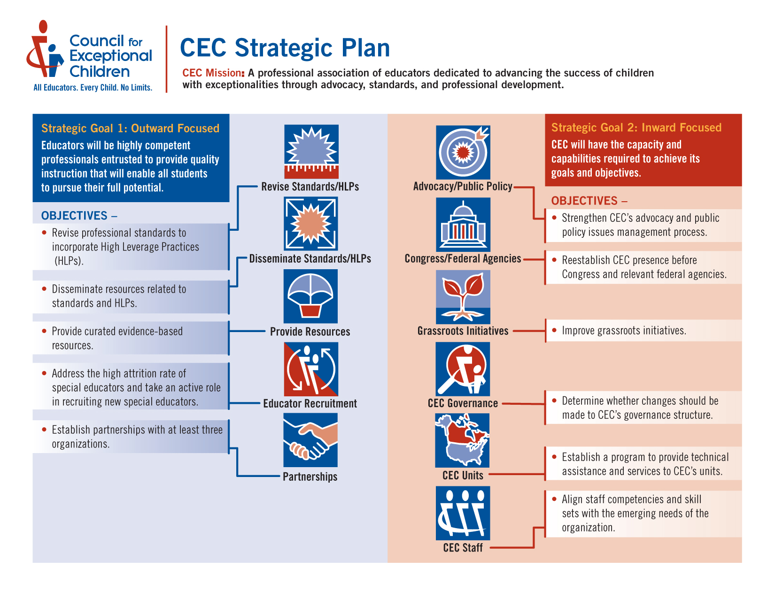
Where we want to be…

Slide 4
Mission and Core Values
Our Mission—who we are, what we do and how we are doing it.
Our Core Values—essential and enduring tenets of the organization - a small set of timeless guiding principles.

Slide 5
CEC’s Mission
A Professional Association of Educators Dedicated to Advancing the Success of Children with Exceptionalities. We accomplish this mission through advocacy, standards and professional development.

Slide 6
CEC Core Values
Visionary Thinking: Demonstrated by forward-thinking and courageous decision making dedicated to excellence and influence in an evolving environment
Integrity: Demonstrated by ethical, responsive behavior, transparency, and accountability
Inclusiveness: Demonstrated by a commitment to diversity, caring, and respect for the dignity and worth of all individuals

Slide 7
Developing an Envisioned Future
External Vision – A Description Of The Conditions We Seek To Achieve for Our Stakeholders in INSERT NAME OF UNIT/DIVISION
Internal Vision – What Will Constitute Success For INSERT NAME OF UNIT/DIVISISON?

Slide 8
Environmental Scan

Slide 9
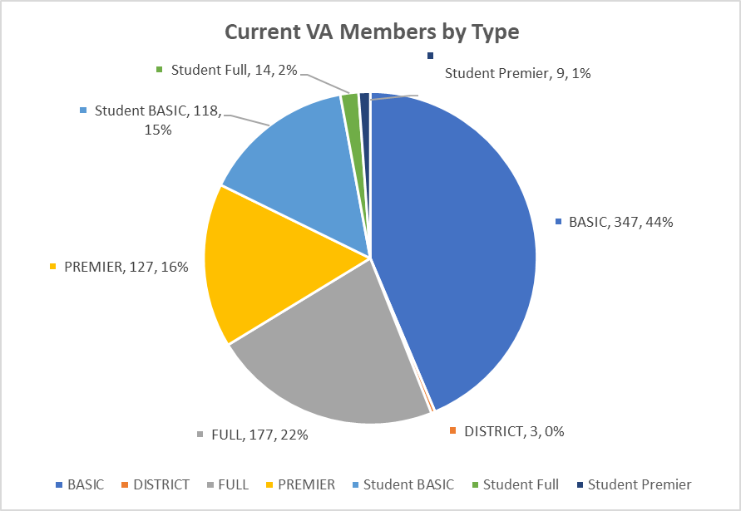
Virginia Member Data

Slide 10
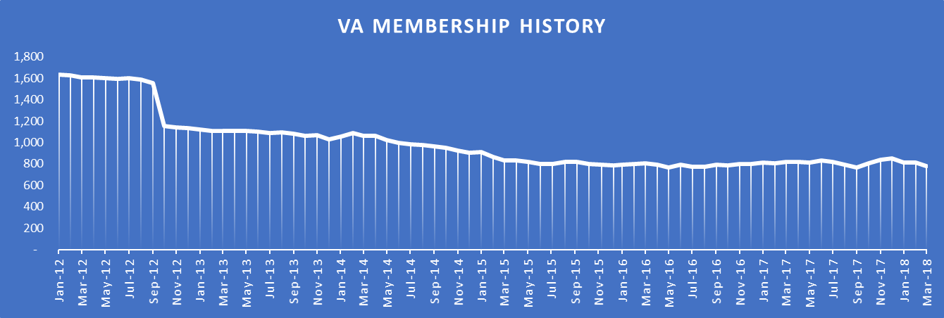
Member Trends 2011-2017

Slide 11
SWOT Analysis
Strengths
Weaknesses
Opportunities
Threats

Slide 12
What are the MEGA issues?
Issues of long term and pervasive importance to the members and the organization.
What we decide will have a significant influence on in all we do.

Slide 13
Establishing SMART Goals
Describe the outcomes the organization will achieve for its stakeholders (members, customers, the organization itself, etc.) in a specific area of focus or business line.
What would constitute success in observable or measurable terms?
Indicates a direction: increase, decrease, all, none, more, reduce, consolidate, abandon, more, less, fewer etc..
Defined for a 3-5 year timeframe.

Slide 14
Determine Strategies and Tactics
What is a strategy?
It is the how in what you will do to achieve a goal.
What is a tactic?
It is what you will do to support a strategy.

Slide 15
Setting Priorities
Impact
Consequence
Immediacy
Notes:
IMPACT:
A measure of “breadth” of importance. How basic or essential is the objective? How many other things depend on it or are related to it?
CONSEQUENCE:
A measure of “depth” of importance. How bad or good will it be if we:
(a) achieve the desired condition;
(b) take advantage of the opportunity;
(c) adequately address the problem?
IMMEDIACY:
A measure of the importance of:
(a) “opportunity” - how much time is available;
(b) “sequence” - how early in the chronology does this need to occur
to correct the problem before it causes irreparable damage or take advantage of the opportunity before it disappears

Slide 17
Next Steps for the Plan
High Level Draft
Board to Review and Refine: establishing strategies, tactics and by when dates! (Go to meeting web-based board meeting.)
Monitoring and Adjustment: each board meeting, not once a year! (Board meeting agenda includes strategic plan discussion and action.)

