Slide 1
Making the most of your website and social media
Alexandra Garvey, Communications Manager
Mason Shelby, Digital Communications Specialist

Slide 2
The Importance of Strategic Messaging
We receive 2,904 messages per day
Of the 2,904,
we notice 52
Of the 52,
we absorb 24
Of the 24,
we dislike 14
Of the 10,
we remember 4

Slide 3
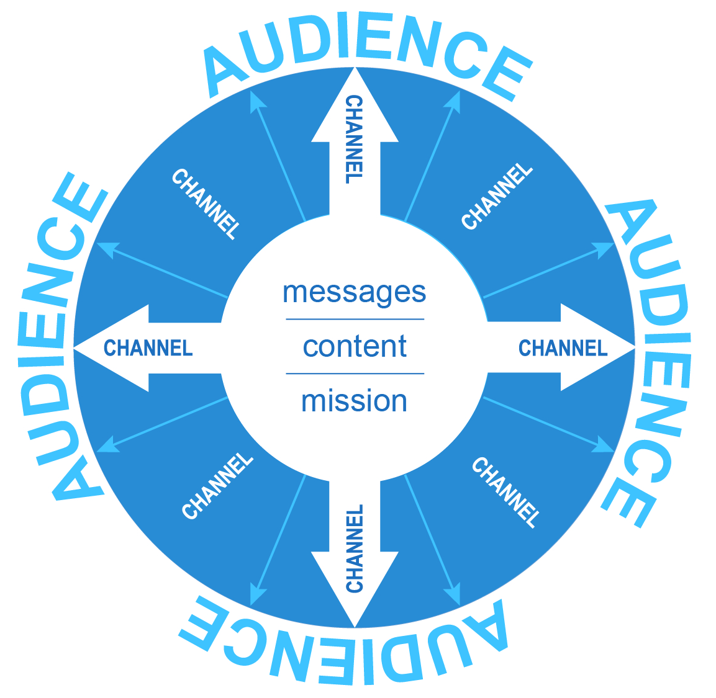


Here’s what it looks like to our audience…

Slide 4
CHANNEL
Here’s what it looks like to our audience…
CHANNEL
CHANNEL
CHANNEL

Slide 5
Creating Engaging Content
High-quality content is relevant and valuable
Identify needs
Start with a story
Notes:
o The words “relevant” and “valuable” are necessary to ANY definition of high-quality content
• Relevant
o The content needs to be relevant, because it needs to be related to the audience’s needs
and interests
o Back to the first slide, we are so used to tuning out the multitude of messages
o Ensures that the content won’t get screened out
o If it’s not relevant, you’re not actually meeting my needs or interests, and why would I be
interested?
• Valuable
o The key to create valuable content is that the content needs to be interesting and useful.
o It can be interesting, useful, value can work in a lot of different ways
o It’s got to give your customer something worth reading or viewing or hearing
• Not about just creating more spam, throwing content over the fence and hoping something
comes back
• The customers will find YOU if you create valuable and relevant content.
• You also need to attract, acquire, and engage your audience, and it helps if it’s a clearly defined
audience. And this will enable you to drive profitable action
You need to have the story first (NOT, “I need FB content…”), and then figure out what elements of
that story may be best at being communicated in different channels
• Once you have the story, find ways to tell it in 140 characters or less or in a 4-minute video
• Get the story first, then we’ll start looking at the channels

Slide 6
The Content Pyramid
PILLAR CONTENT
REPURPOSE INTO MICRO CONTENT
One long-form piece of content from which all other content is derived
Create short-form pieces of content (i.e., infographics, images, quotes, blog posts, GIFs, video vignettes, etc.)
DISTRIBUTE ACROSS CHANNELS
Distribute content on relevant platforms

Slide 7
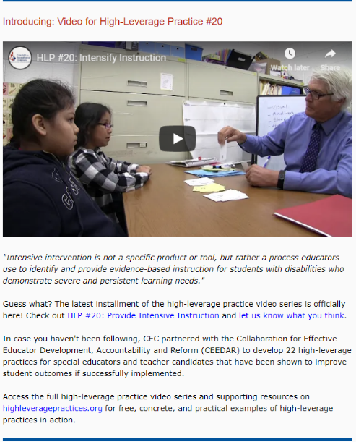


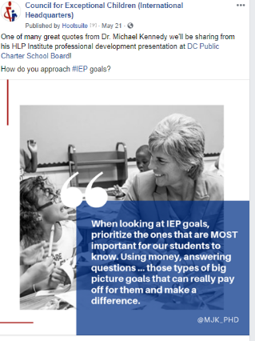
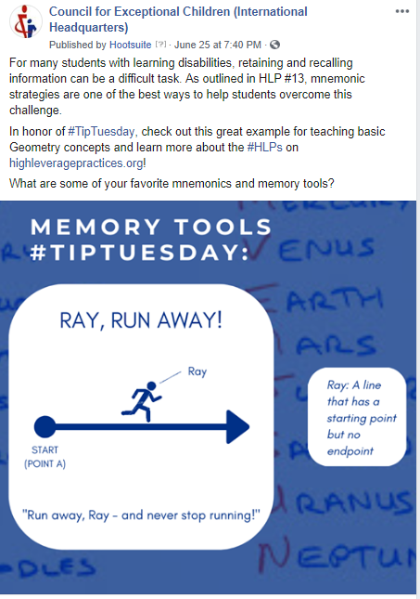

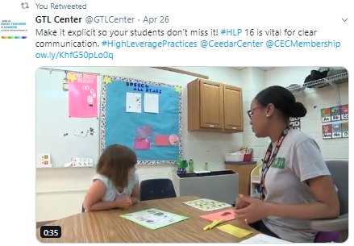
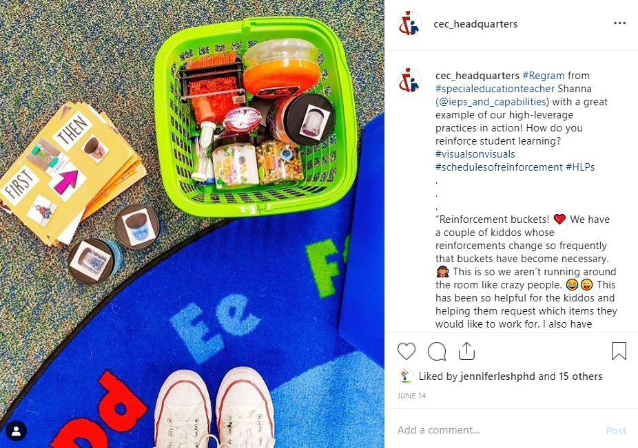

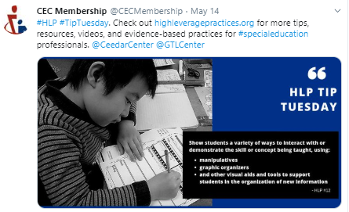


Slide 8
Your turn!
Notes:
State of the Profession
- How can you apply this?

Slide 9
Higher Logic Walk-Through
Now, let’s log into the community.
  From a microsite perspective, here’s how to make it happen.

Slide 10
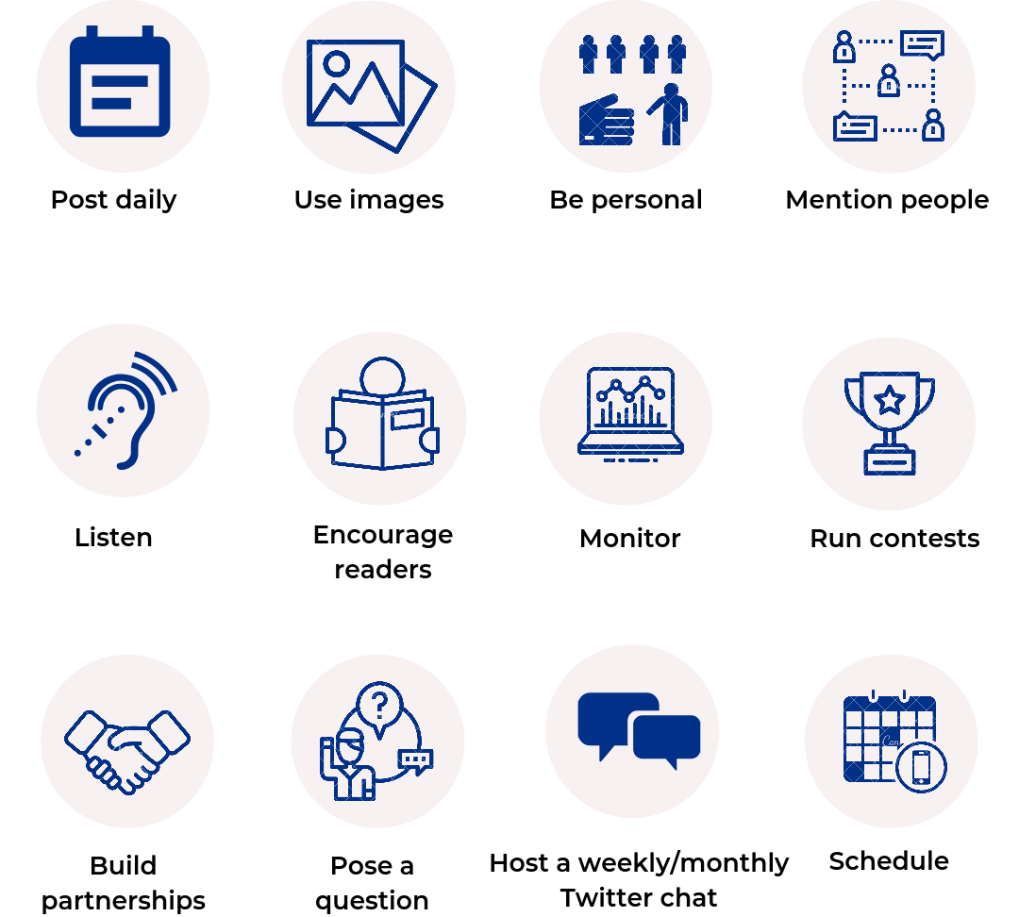
Social Media: Ways to Engage

Slide 11
Questions?

