Slide 1
The Top Ten Tips for Successful IEP Facilitation
CEC Student Teacher Resources
Part 2

Slide 2
Discuss in Detail……
Don’t discuss other students or disclose confidential information.
Remember that parents don’t need to hear other students’ names or circumstances. You must protect confidentiality.
Some parents will want to compare services and you will politely state that you are not able to discuss that, and it would not be relevant.
Redirect the dialogue to their student’s individual needs and find something you might offer that addresses the need.

Slide 3
Discuss in Detail……
Fair is not always equal
Don’t comment what is “fair.”
When discussing what a student requires in an IEP meeting, parents will react negatively if they hear from teachers that it is “not fair” to give one student one thing that others do not get.
Help your general education colleagues refrain from this too.
Avoid using judgmental or emotional language.
Ensure the team considers LRE and the full continuum.

Slide 4
Discuss in Detail……
Don’t present parents with a completed IEP.
Follow your district’s procedures.
The IEP decisions should be discussed/developed as a team.
Be sure to complete each section thoroughly even when using an electronic IEP format.
Don’t use N/A.

Slide 5
Discuss in Detail……
PWN
Don’t refuse to consider an idea or request.
Professionally consider any suggestion offered by team members, especially parents.
Document that you considered and accepted, modified, or rejected the request.
Parents must be considered informed participants.
This information is necessary for the prior written notice.
Be flexible and listen!

Slide 6
Discuss in Detail……
10. Don’t remain silent!
All teachers have credibility and voice.
Be confident and professionally follow procedures and discuss IEP topics.
When you don’t speak up, it can alter the balance of dialogue and decision making.
Be sure to be prepared with data and progress monitoring.

Slide 7
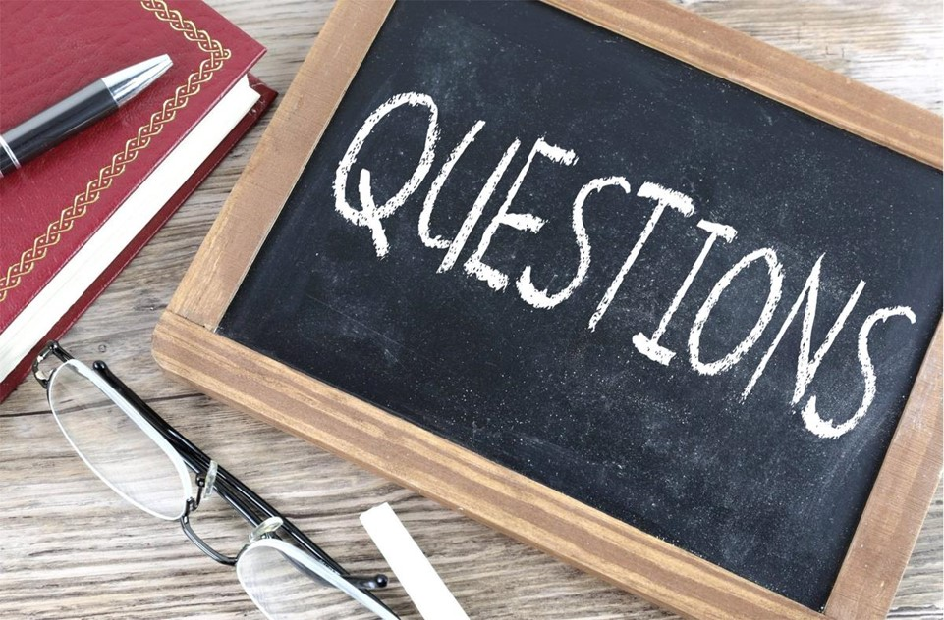
Thank you for Watching!
If you have questions, please reach
out to me:
My contact info:
Jane Strong, Ph.D.
Middle Georgia State University
jane.strong@mga.edu

